Slide 1
online bookmarking system
Project Report

Slide 2
Introduction
Delicious is a free service designed with care to be the best place to save what you love on the web. We keep your stuff safe so it's there when you need it – always. Delicious remembers so you don't have to. • It's easy to build up a collection of links, essentially creating your own personal search engine. It's quick to organize your links so that when you’re looking for something, you can find it within seconds

Slide 3
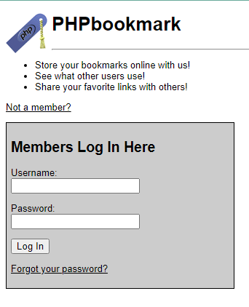
Login Page

Slide 4
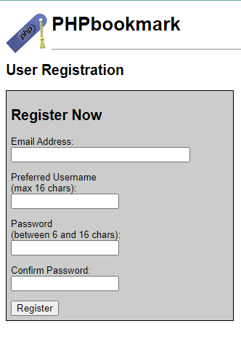
Registor

Slide 5
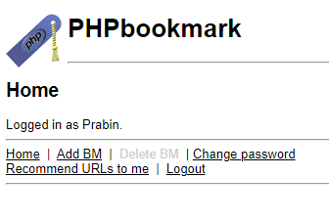
Home Page

Slide 6
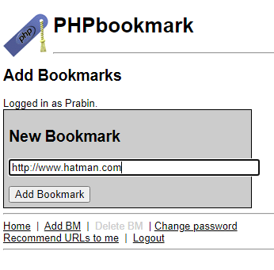
Add Bookmarks

Slide 7
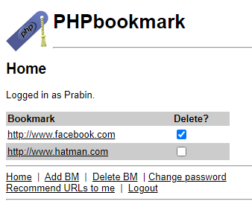
Delete Bookmarks

Slide 8
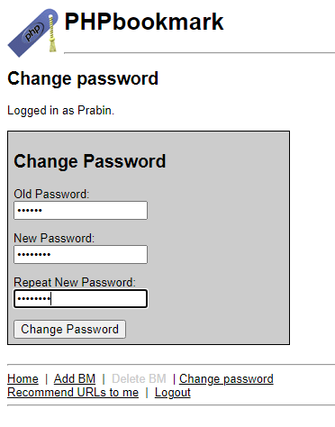
Change Password

Slide 9
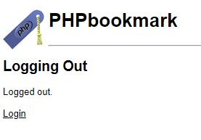
Logout

Slide 10
future enhancements
The project has a very vast scope in future. The project can be implemented on intranet in future. Project can be updated in near future as and when requirement for the same arises, as it is very flexible in terms of expansion. With the proposed software of database Space Manager ready and fully functional the client is now able to manage and hence run the entire work in a much better, accurate and error free manner. The following are the future scope for the project.
Admin Side controls
Bar code Reader based system
Individual bookmarks with photo

Slide 11
Thank
You

